Slide 1


Student Transfer:
Primary Use Case for
JSON Transcript Development
& Pathway to JSON-LD
Featured Speakers
John Lovell, Technology Director, Access 4 Learning Community
Michael D. Morris, Senior Software Engineer in Test, ACT, Inc.
Rick Skeel, Product Manager, Ellucian
Notes:
MICHAEL SESSA MODERATOR

Slide 2

AGENDA
Welcome & Introductions
Brief History on Transcript
Why JSON Transcript?
Why Student Transfer?
Differences in XML vs. JSON
Brief Technical Overview of JSON
Why JSON-LD?
Notes:
MICHAEL SESSA COORDINATES INTRODUCTIONS

Slide 3
Brief History on Transcript
The transcript in higher education
The transcript in PK12
Paper, EDI & XML
How transcripts are used, by whom
Notes:
RICK AND JOHN

Slide 4
Why JSON Transcript?
What is JavaScript Object Notation?
Wikipedia:
JSON is an open standard file format and data interchange format that uses human-readable text to store and transmit data objects consisting of attribute–value pairs and arrays (or other serializable values). It is a common data format with a diverse range of functionality in data interchange including communication of web applications with servers.
Where and how JSON is used
A4L
ACT
Ellucian
Notes:
MICHAEL MORRIS, RICK AND JOHN

Slide 5
Why Student Transfer?
What is student transfer?
Current initiatives on student transfer
What is a use or business case?
Notes:
RICK

Slide 6
What is JSON:
A subset of JavaScript Programming Language (no functions)
Light weight text-based data exchange format
Used by most RESTful web services (APIs) for both request and response data
Direct serialization of internal data structures such as dictionaries and lists
Notes:
MICHAEL MORRIS AND JOHN

Slide 7
What is JSON:
Used by most RESTful web services (APIs) for both request and response data. JSON has replaced XML for this application
Used for data exchange in A4L, HR Open Standards, NIEM, IMS Global, etc.
Notes:
MICHAEL MORRIS AND JOHN

Slide 8
JSON EXAMPLE
{
"firstName": "Michael"
"lastName": "Sessa"
"address": {
"streetAddress": "1250 Connecticut Avenue NW",
"city": "Washington",
"stateProvince": "DC",
"postalCode": "20036"
},
"web": ["www.PESC.org", "facebook.com, PESCUpdates", "twitter.com, PESCUpdates"],
"phone": "+202-261-6516"
}
Notes:
MICHAEL MORRIS AND JOHN

Slide 9
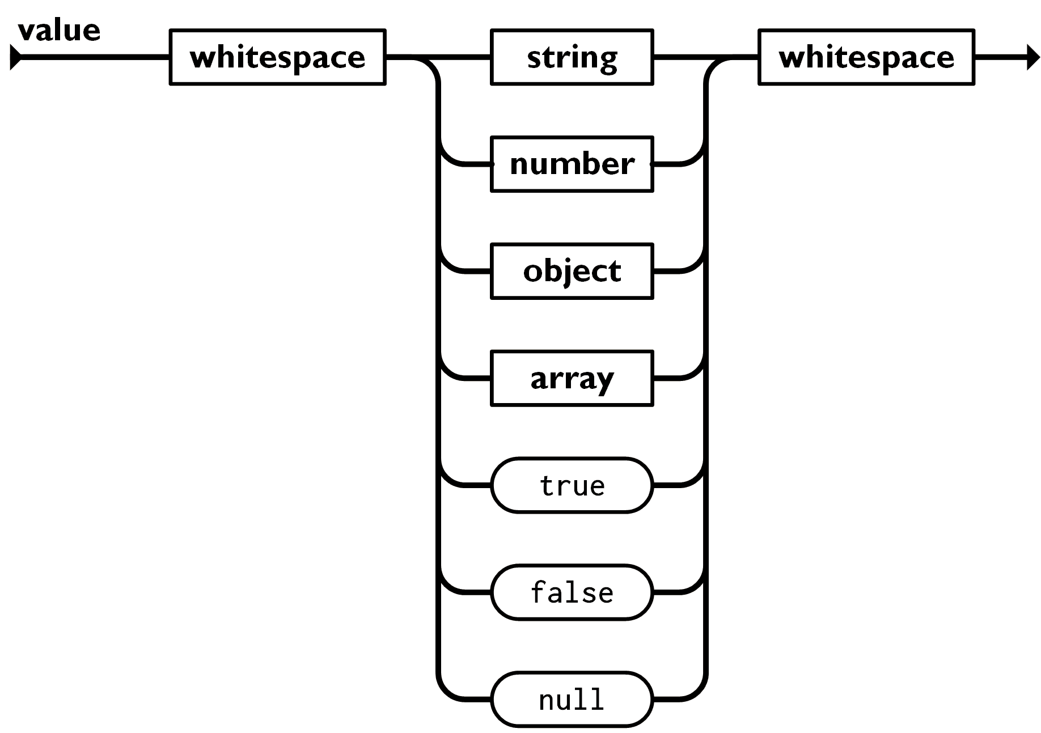
JSON Syntax
"Michael"
6.022E23
666
64.6
{"name": "Michael",
"location": "Iowa City"}
[1, 5, 9]
["a", "b, "c"]
[{"name": "Michael"},3, false]
true
false
null
Notes:
MICHAEL MORRIS AND JOHN

Slide 10
Differences in XML vs. JSON
JSON is easier to read by humans.
JSON is easier to manipulate with most programming languages.
JSON has smaller payloads and less bandwidth required for tranmission.
JSON is easier to learn and understand.
XML provides attributes to help qualify tags so more sophisticated models can be expressed
XML allows control of the ordering of elements whereas JSON object properties are not ordered.
Both have a defined schema language that can be used to validate instance documents.
Both can be used in RDF applications
Notes:
MICHAEL MORRIS AND JOHN

Slide 11
Differences in XML vs. JSON
Notes:
MICHAEL MORRIS AND JOHN

Slide 12
Why JSON-LD?
What is JSON for Linked Data?
Wikipedia:
JSON-LD is a method of encoding linked data using JSON. One goal for JSON-LD was to require as little effort as possible from developers to transform their existing JSON to JSON-LD. JSON-LD allows data to be serialized in a way that is similar to traditional JSON.
Role of RDF – Resource Description Framework
“Searchable & Discoverable”
Notes:
JOHN, MICHAEL MORRIS AND RICK

Slide 13
QUESTIONS?
Contact Information
John Lovell jlovell@a4l.org
Michael Morris michael.morris@act.org
Rick Skeel rick.skeel@ellucian.com
Websites & Links
https://www.a4l.org/page/Unity
https://www.pesc.org/json-transcript-workgroup.html

